Slide 1
.

Slide 2
Educazione civica
Obiettivo 5: Raggiungere l’uguaglianza di genere e l’autodeterminazione di tutte le donne e ragazze

Slide 3
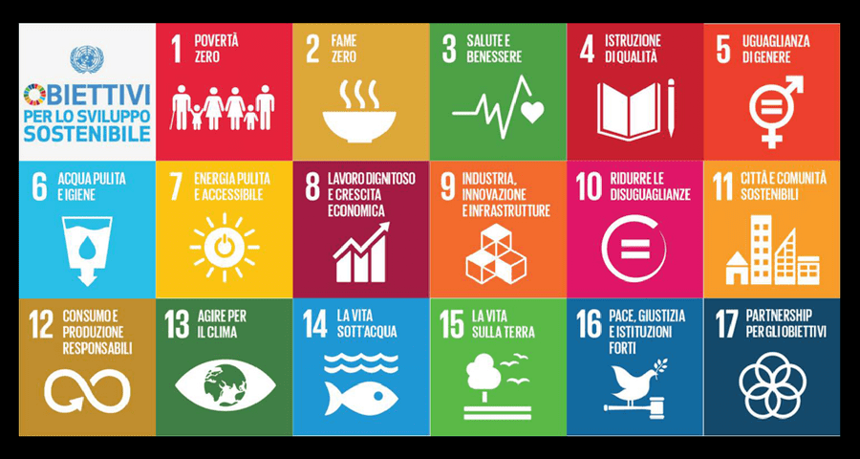

Slide 4
Questioni di genere: il difficile cammino verso la vera parità
Le attività del progetto, rivolto alla classe quinta dell’Istituto Tecnico Economico per il Turismo Argoli di Tagliacozzo, hanno avuto come obiettivo prioritario quello di fornire agli studenti una panoramica sul tema del genere fornendo loro gli strumenti per costruire un discorso analitico ed individuare/decostruire gli stereotipi sul genere. In particolar modo sono stati affrontati i temi attraverso un brainstorming e la costruzione partecipata dei quadri concettuali: costruzione sociale della divisione tra i sessi, elaborazione culturale della differenza sessuale, significati attribuiti al maschile/femminile come storicamente contingenti, modelli culturali di genere, stereotipo come rappresentazione preconcetta della diversità.
L’obiettivo è stato quello di avere futuri cittadini e cittadine consapevoli e attivi in tutti i contesti di vita, nella società, nella famiglia e nel lavoro. Un percorso coerente con il rispetto e la valorizzazione della differenza è un’opportunità per condurre tutti alla definizione di una identità di genere più libera e alla consapevolezza della pervasività degli stereotipi di genere nei linguaggi didattici, comunicativi e metacomunicativi, così come nella cultura e nella società, per mirare ad un processo di insegnamento/apprendimento paritario, sensibile e consapevole delle soggettività e delle potenzialità di ogni alunno e alunna indipendentemente dal sesso di appartenenza.
Sono stati esaminati altresì articoli legislativi riguardanti il genere attraverso un brainstorming e la costruzione partecipata dei quadri concettuali: Costituzione italiana (art.3, 29, 37, 51) e principali leggi di riferimento e norme che disciplinano le relazioni di genere all’interno della famiglia e della società

Slide 5
PROGETTO CLIL: Donna e scienza, il difficile e ostacolato percorso della donna scienziata Referenti: prof.ssa Mordini Esterina (italiano) e prof.ssa Di Domenico Daniela (lingua inglese)
Women who
made THE difference.
DONNE CHE HANNO FATTO LA DIFFERENZA.

Slide 6
C l i l
Obiettivo formativo: assumere la prospettiva di genere per diventare consapevoli delle radici culturali, sociali,
politiche ed economiche che stanno alla base di discriminazioni, violenze e disuguaglianze di genere e per dar vita a una società più equa e rispettosa delle differenze
La trattazione di degli argomenti, avverrà in lingua italiana e inglese. Il lavoro didattico si avvarrà di supporti multimediali che facilitino la comprensione e l’ascolto con la pronuncia corretta. Questo per consentire una preparazione adeguata degli studenti per lo svolgimento della prova d’esame che potrebbe coinvolgere anche la lingua inglese.

Slide 7
OBIETTIVI: PROGETTO CLIL, FINALITA’ E METODOLOGIE
Conoscenza di biografie di donne significative del ‘900, donne che hanno contribuito alla storia dell’umanità Competenza nell’argomentare in italiano e in lingua pensiero e azioni incisivi nella società di donne che hanno operato in situazioni di difficoltà o discriminazioni di genere Competenza a sostenere un discorso/debate in lingua italiana e in inglese su questioni di genere

Slide 8
RISORSE DIDATTICHE ED ORGANIZZATIE
Le lezioni interattive si svolgeranno nell’aula della classe, in modalità LIM oppure nell’aula virtuale . Le 5 lezioni saranno di due ore (una di italiano e una di inglese) e si terranno per 5 venerdì da gennaio 2021.I materiali saranno predisposti dalle docenti (materiale cartaceo, digitale, video, documentari).

Slide 9
Link sulle donne nella scienza
https://www.sciencefocus.com/science/10-amazing-women-in-science-history-you-really-should-know-about/

Slide 10
Modalità di promozione/comunicazione degli esiti progettuali (ed eventuale prodotto finale) e valutazione finale
My CLIL imaginary
interview
BY FRANCESCA SALVATI - VC
Il lavoro conclusivo del progetto sarà un prodotto multimediale, da presentare in sede di Esame di stato.
Indicare quali modalità di valutazione si intende utilizzare(questionari, sondaggi oppure certificazioni conseguite ecc.):
La valutazione sarà accordata dalle due docenti per ciascuna delle due discipline dopo averla concordata relativamente al lavoro prodotto

Slide 11
Samantha Cristoforetti
As part of the Clil project about "Women who have
changed history", I have decided to interview
(imaginary)the Italian astronaut Samantha
Cristoforetti, also nicknamed "Astrosamantha".
Born in 1977, Dr Cristoforetti was the first Italian
woman in the crew of the European Space Agency.
In 2015, she also set a new record for women to stay
in space: 199 days. This record was reached during
the ISS Expedition42/Expedition43 mission between
2014 and 2015.

Slide 12
Why this choice?
PERSONAL INTEREST
I wanted to find out more
about her
COMPETENCES
worldwide recognized as
one of the best astronauts
ORIGIN
Dr. Cristoforetti comes from
Milan, Italy

Slide 13
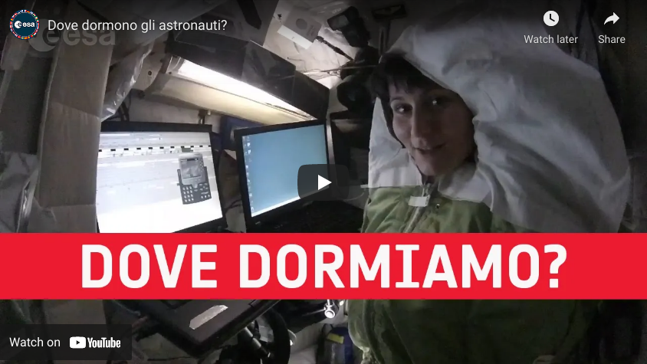
Sources
To study about Dr. Cristoforetti I
have read some of her "real"
interviews and saw the officials
video-interviews on YouTube.
At now, she is still alive so I have
found a lot of materials to
document my research.
Sources
To study about Dr. Cristoforetti I
have read some of her "real"
interviews and saw the officials
video-interviews on YouTube.
At now, she is still alive so I have
found a lot of materials to
document my research.

Slide 14
Interview with Virginia Woolf Alunna: Giorgia D’Alessandro vc
GD: Good evening Mrs. Woolf, thank you for granting me this interview that will surely enlighten many of your readers and let us discover a little more about a great woman like you are. I would like to start with a very personal and profound question, if that's okay with you.
VW: Sure miss, I'm here just to bring to light that side of me that not everyone knows, I will answer all kinds of questions, from the most superficial to the most profound, even if I think nothing is superficial when it comes to discovering a person, even more so when it comes to a woman.
GD: You're right, every little detail is useful for getting to know a person. I would like you to tell me a little about your childhood, I know that you lost your mother when you were very young, How did you deal with this tragedy?
VW: I grew up in an environment richly influenced by the Victorian literary society, my father being a famous scholar of the time. I was unable to attend any educational institution due to the Victorian education rule that required little girls to stay home and learn how to become good wives and mothers; luckily my mother gave me lessons in Latin and French and my father allowed me to read his books. I remember the summers I spent at Talland House, our summer residence, in Saint Ives in Cornwall, where I spent the happiest moments of my childhood every summer until 1895. Shortly after, at only 13, my mother died; it was a hard reality to accept, then added to the death of my father and that of my stepsister they determined a serious nervous breakdown for me, I heard voices in my head, I was not at all well

Slide 15
.
I do not doubt that when I was forty the presence of my mother's ghost still haunted me. I could hear her voice, see it, imagine what she might say or do. I wrote "To the lighthouse" very quickly; and when it was written I stopped being obsessed with my mother. I suppose I did to myself what psychoanalysts do for their patients, I expressed my deepest emotions in order to reconcile with them. Well, we could say that this book was for me an attempt to cope with the pain of loss.
GD: Regarding the girls who had to stay home and learn how to become good wives and mothers, what is your opinion on this?
VW: As I have already said, women were taught to fulfill housekeeping duties, to submit to the wishes of the head of the family, not to aspire to a profession or independence. I myself had to undergo the control of my father, my brothers and finally my husband. To answer the question I will quote myself, with a phrase in my book "A room of one’s own": "A woman must have money and a room of her own to write novels". I think you notice how for me the road to emancipation can only be reached through economic, and above all, cultural independence. Even if a woman is obliged to follow the rules, no one can ever take away her freedom of thought. In almost all of my books, female characters experience a moral dilemma between what is right for society and what is desired. In “Mrs Dalloway”, for example, the protagonist shows great audacity, so much so that she questions her husband's ideas, according to which women are not required to oppose the choices of the head of the family.

Slide 16
.
GD: Speaking of what I think is your masterpiece “A room of one's own”, what do you intend to communicate to the reader?
VW: With this essay I have retraced the literary history of women. The ultimate goal of my thesis is to claim, for the female gender, the possibility of being admitted to a culture from which until that moment they had been excluded, in a deeply male-dominated society. But the most important intent of my book is precisely to deconstruct this patriarchal language in the literary and social sphere. The very fact that I decided to express my opinion was revolutionary. Basically what I have always wanted and still want to communicate is that women have always fought for their rights, they have always fought for their place in society but have had to contend with a profoundly male chauvinist reality that has always put them by part aside. Well, my message is to react, to fight even more, to fight even harder and above all to stand up and never give up. I believe in equality of the sexes, in the strength of women, in their determination and their independence.
GD: Moving on to another front, Leonard Woolf was the love of his your life, but not the only one ... right?
VW: Right. I met Vita Sackville-West in the winter of 1922, a month after our meeting she was a guest at my home. I was very suspicious but in the end I was bewitched by the charm of that woman, who was married to Harold Nicolson, an English parliamentarian who was also a homosexual

Slide 17
.
Our love story could be compared to a soap opera, it is so full of controversies and twists. Vita seduced women, exercised an extraordinary power over them, masculine and maternal at the same time. Despite my marriage made of affinity and understanding, I loved women, magnificent presences in front of which relationships with men seemed boring and sterile. Our relationship lasted 15 years, between overwhelming moments and months passed without any contact.
GD: Has your bisexuality influenced your works in any way?
VW: In my opinion, every event in an artist's life affects his works, I can't tell you how. However, I can tell you that I was so chained to that woman that I dedicated a novel to her, "Orlando", which I published in 1928. The work is really full of references to Life, just simply think of the habit, common to the character and my beloved, of appearing in society with men's clothes.
GD: But the thing that intrigued me more and more and that I never really understood fully, is how it is possible that a woman like you so strong and determined, could have decided to end her life in that way ...
VW: My crises became more and more violent, when I was alone I fell back into a state of anxiety and mood swings. The progress of the war also increased my phobias. That March 28, 1941 I decided to end it all. I am, or rather, I was a strong woman, it is true, but all my weaknesses slowly came out. My life was no longer the life I wanted. I hope you can understand the reason for my decision from this note which I left to my husband before I made my final gesture

Slide 18
.
“Dearest, I'm sure I'm going crazy again. I feel like we can't go through another one of those terrible moments. And this time I will not heal. I start hearing voices, and I can't concentrate. So I'm doing what seems like the best thing to do. You have given me the greatest happiness possible. You were in every way everything that no one could ever be. I don't think two people could have been happier until this terrible disease came. I can't fight anymore. I know that I am ruining your life, that without me you could go on. And you will I know. See I can't even write this properly. I can not read. What I want to tell you is that I owe all the happiness of the
my life to you. You have been completely patient with me, and incredibly good. I want to say - everyone knows. If anyone could have saved me it would have been you. Everything has gone from me except the certainty of your goodness. I can't keep ruining your life. I don't think two people could have been happier than we have been. " A final weakness does not erase all the strength I have had until then, this is also a message that I would like to convey to all women.
GD: As I said even before asking you the first question, your life and work was enlightening to me. Your latest answer makes it clear even more how persistent you have been. I want to thank you again for allowing me to carry out this interview, I am infinitely grateful to you for having had the courage to claim the role of women in society, and obviously for having transmitted your deals to people. I would like to conclude the interview with a very significant question for me: what should a woman do to live her life to the fullest?
VW: To answer this question, I quote a phrase dear to me that is part of A room of its own: “Without any need to hurry. No need to spark. No need to be other than yourself ".
ULTERIORI MATERIALI E INTERVISTE IN POSSESSO DELLE DOCENTI REFERENTI DEL PROGETTO

Slide 19
