Slide 1
ZONGULDAK

Slide 2
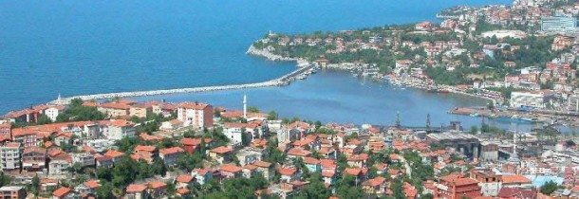

Slide 3
Zonguldak (Greek: Sandraka) is a city and the capital of Zonguldak Province in the Black Sea region of Turkey. Its population according to the 2000 census was 104,276. It is an important port on the Black Sea, and is famous for its coal mine
ETYMOLOGY OF THE NAME
The city's name probably comes from Zone Geul-Dagh, the name given to the area by French and Belgian mining companies. Göldağı ("Lake Mountain") is the highest mountain in the vicinity of Devrek district.
Following information about Ereğli coal mining history, will help us to understand Zonguldak name is originated from Zone Geul-Dagh in French: (In Catholic Encyclopedia, with reference of year 1908, Zonguldak town is called as "Zoungoul-Dagh" or in Turkish, Zoungoul mountain; or with Turkish+French meaning, Lake/Göl mountain zone... "Goul-Dagh is a mountain on the south of Zonguldak town, with a little lake... It was a reference benchmark for the new mining zone and sea port location in Eregli region after 1860s.")

Slide 4
BRIEF HISTORY
We know that the discovery of coal in Ereğli (Heraclea) region dated to the reign of Sultan Mahmud II and its extraction dated to Abdülmecid's reign.
The first specimen of Turkish coal was brought from Ereğli to Istanbul in 1822, but nothing was done for exploration and exploitation of this coal. However, in 1829, another specimen of coal was brought to Istanbul by Uzun (The Long) Mehmet, a sailor and native of the village of Kestaneci, near Ereğli. This time attention was given to the discovery and the sailor received a reward of a life pension, but before he could benefit from this reward he was murdered.
The first miners requested and delivered from the Austrian Government are the Austrian Croats known to have been employes in the Ereğli Coal Mines. The correspondence between Istanbul and the embassy in Vienna show that coal production in the Ereğli Basin predates the March 1837 request by 18 months and that production started around September 1835.
An investigation of Hazine-i Hassa (Ottoman Imperial Treasury Department) records in the Ottoman archives shows that regular mining activities in the Ereğli Basin started in February 1841. This is confirmed by a newspaper article published in the 14 February 1841 issue of Ceride-i Havadis.

Slide 5
CLIMATE
Zonguldak has an oceanic climate (Köppen climate classification; with high and evenly distributed rainfall the year round. Summers are warm and humid, and the average temperature is around 21 °C in July and August. Winters are cool and damp, and the average temperature is around 6 °C in January and February.
Precipitation is heaviest in autumn and early winter and lightest in spring. Snowfall is quite common between the months of December and March, snowing for a week or two, and it can be heavy once it snows.
The water temperature like in the whole Turkish Black Sea coast is always cool and fluctuates between 8° and 20 °C throughout the year.

Slide 6
CAVES Cehennemağzı Cavern, Gökgöl, Kızılelma, İnağzı and Cumayanı Caverns should be seen. Cehennemağzı Caverns (Karadeniz (Black Sea) Ereğli): Cehennemağzı Caverns, which are also mentioned as "Caverns at Acheron - Akheron Valley" in the archeological sources of antic age, (Kehanet Caverns) is at the İnönü District, which is formerly named as Ayazma, of Ereğli, and is the mutual name of four caverns. Cehennemağzı Caverns, with being subjected to Greek Mythology, during the periods when Christianity was prohibited, is one of the worshipping places, thought to be used for secret worshipping.

Slide 7
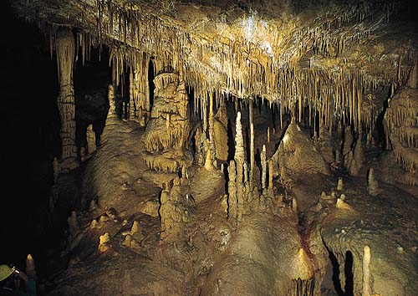

Slide 8
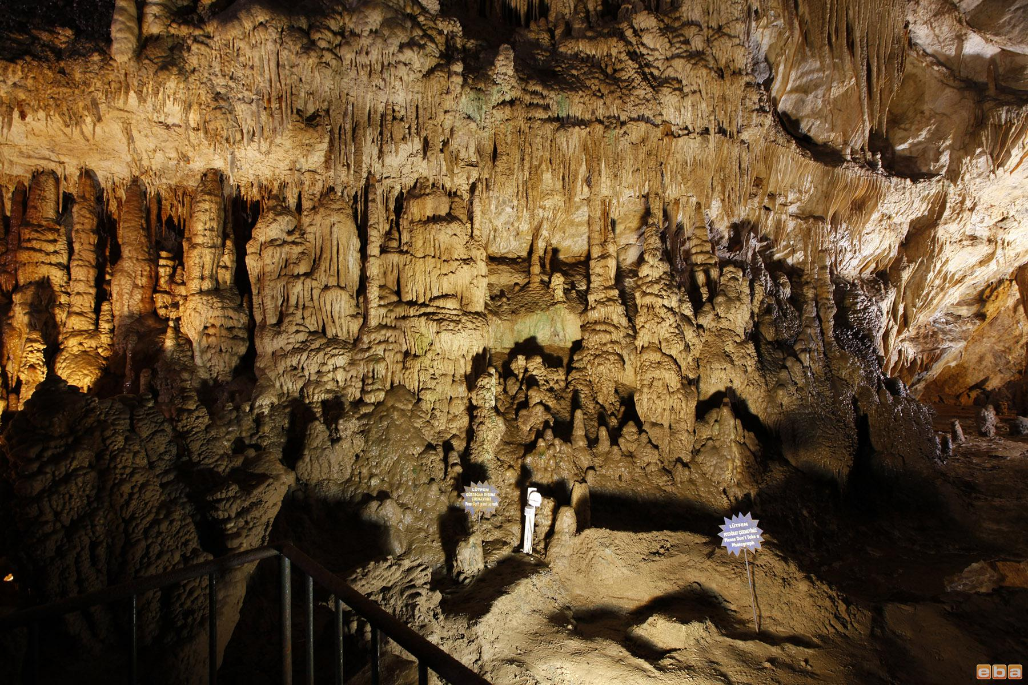

Slide 9
ZONGULDAK CUISINE
The first province declared following the founding of the Republic of Turkey, Zonguldak has a deep-rooted history that has been host to numerous civilizations. In addition to seafood in its coastal areas, agricultural and animal production in its inner parts define the region’s gastronomical cultu One can hardly get enough of the baby chestnuts growing in the forests of Zonguldak. In addition to its chestnuts, chestnut honey is also a delicacy quite unique to the region. A dark, bitterish concoction, this honey is known as an “elixir of youth” due to its rich content. In addition to chestnuts, the forested area in Zonguldak and its vicinity is populated by cranberry, blackberry, medlar, rosehip, basil, bay, wild strawberry, and wild cherry. The local population exploits these flavors in its cuisine to a considerable extent.
Particularly in Ereğli in the Black Sea region, there is a type of Ottoman strawberry that grew here, once regarded as highly delicious and named eponymously…. The building blocks of the local cuisine are made from wheat and corn flour. Ovmaç, kesme, pumpum, and öğre soup; hüpbülü beet dish, cimcük pasta, gırtıl, beddam mancar, vinegar bambam, çükündür mancar, tıntış, laylanga, hodan roast, flour gulu gulu, kirli ayşe, merdane dessert, and güccek are delicacies unique to the region.

Slide 10
